Slide 1
Git Quick Guide

Slide 2
Clone git repository
Cloning repository is a one time activity. You need followings:
Git for windows installed in your machine
Github account – username and password
Gitbub repository url

Slide 3
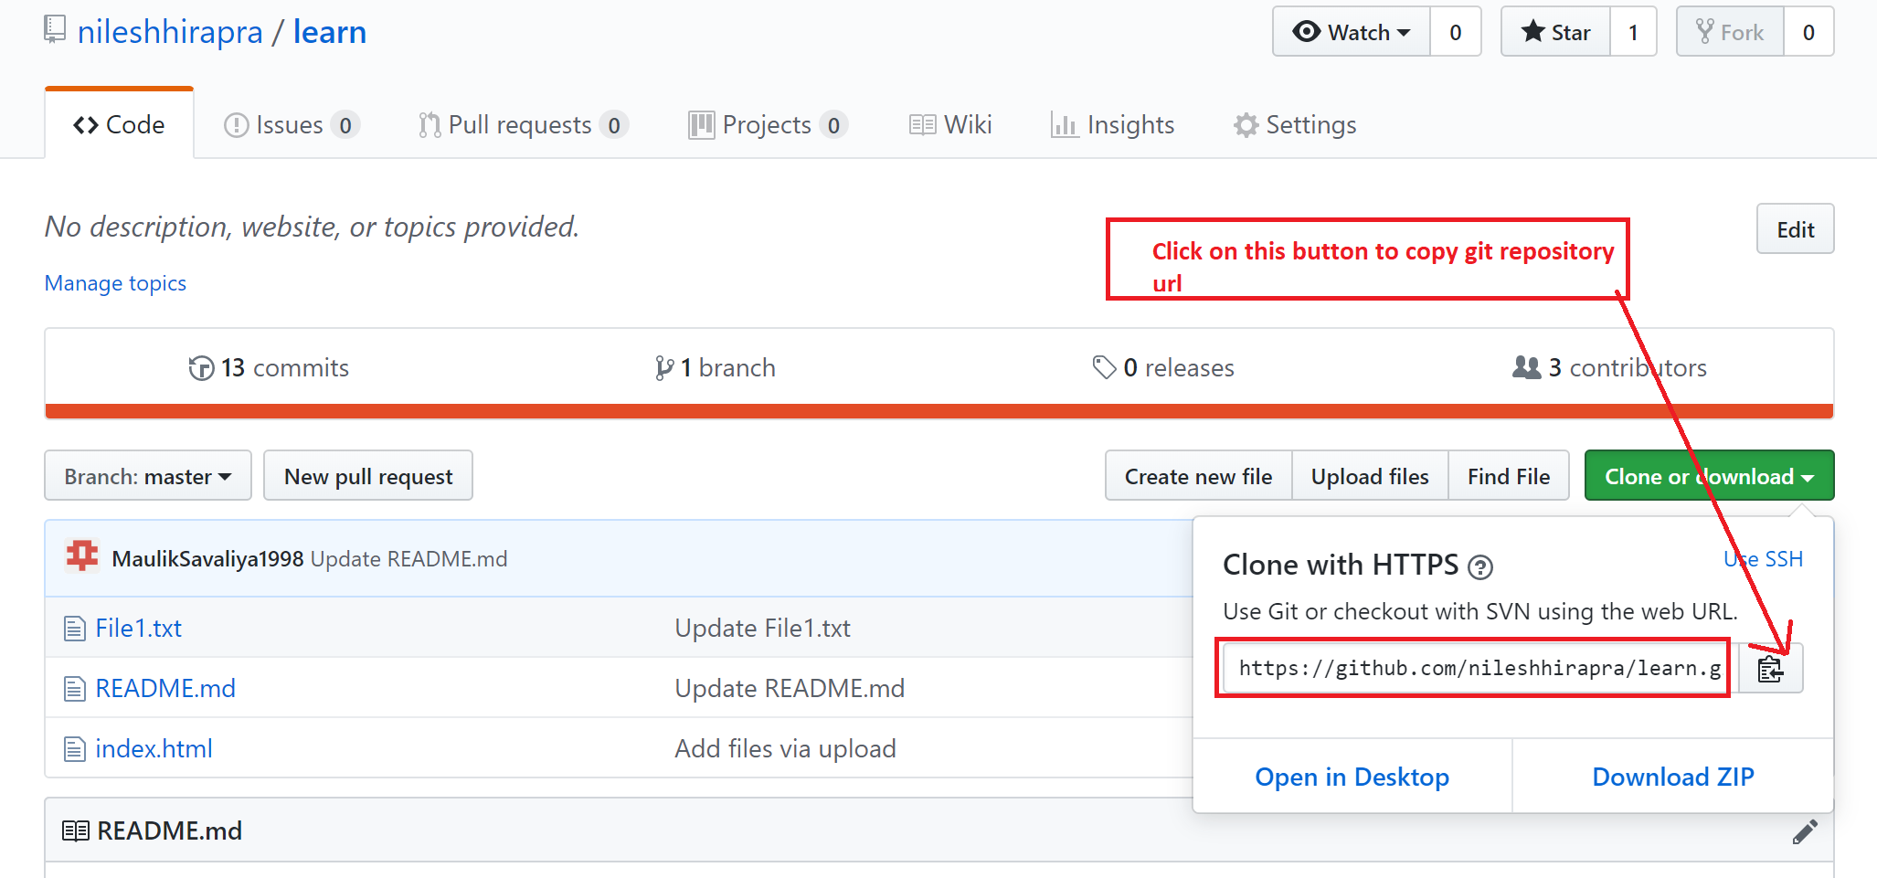
Copy git repository url from github repository page as shown below

Slide 4
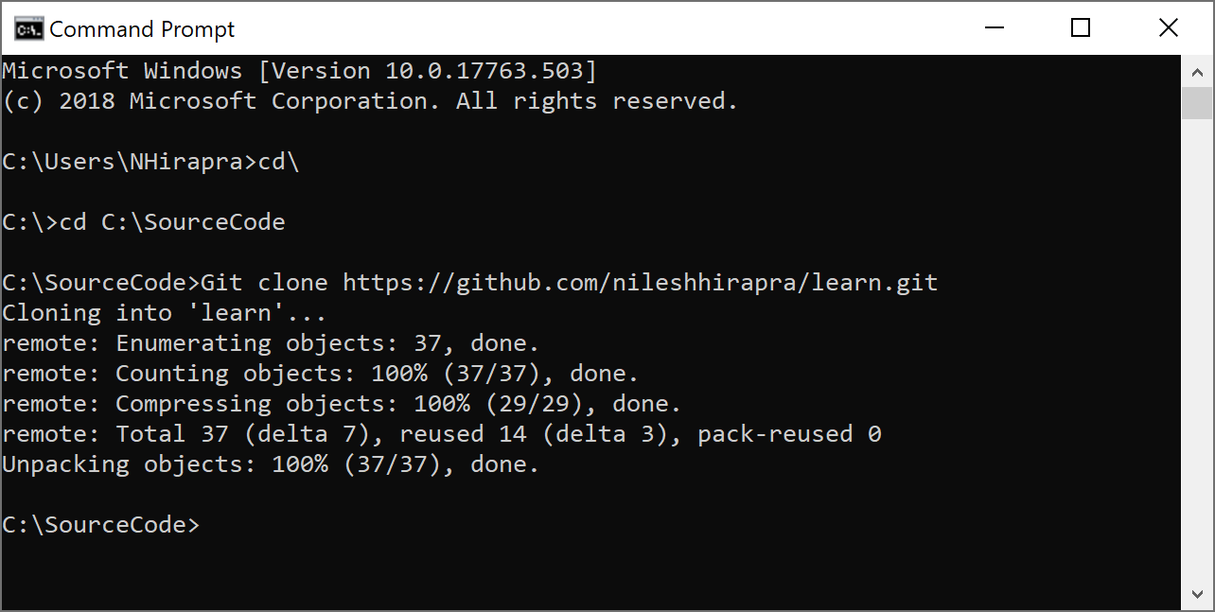
Clone GitHub repository
Create a local folder where you want to clone repository.
For example: C:\SourceCode folder
2. Open Command Promot and navigate to this folder
3. At prompt type following command
Git clone <repositoryUrl>
Example:
Git clone https://github.com/nileshhirapra/learn.git
4. See result on clone in screenshot at right.
5. Now code repository is cloned in your machine and you can see code folder
Example “Learn” folder in C:\SourceCode folder
6. Change directory to Learn folder
7. Now you can use git commands here

Slide 5
How git and GitHub works?

Slide 6
Github
{A} – Push code to local repository
Git Add *
Git commit –m “Message”
{B} – Push committed code to github
Git push
{C} – Download/pull latest code
Git pull
{B}
{C}
Local Machine
Git local repository
https://git-scm.com/docs/git-add
{A}
https://git-scm.com/docs/git-commit
https://git-scm.com/docs/git-push
https://git-scm.com/docs/git-pull
Folder

Slide 7
Git push and login

Slide 8
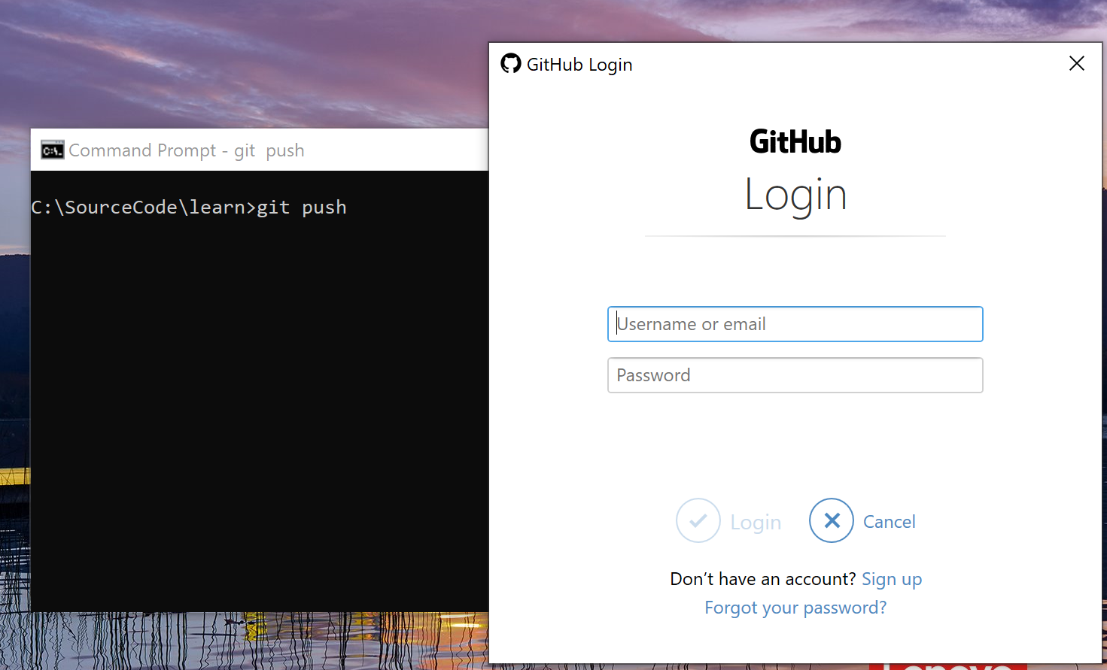
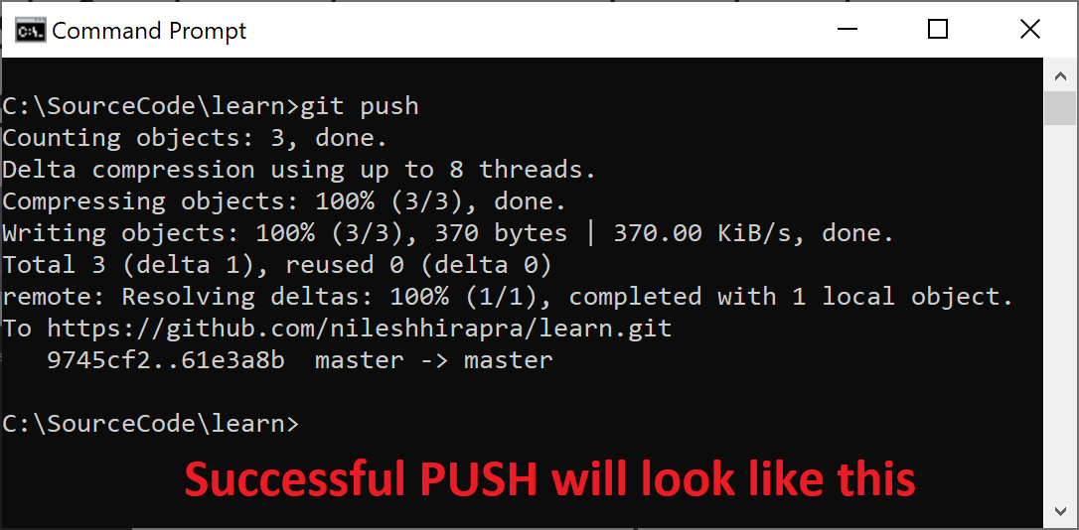
Git will ask for login/account details when you try to push changes to GitHub first time
Provide your Github username and password in Github Login screen

